Slide 1


Making the Most of Microservices
Blaize Stewart – Architect
MCSE, PCSA, MVP, and MCT
bstewart@Wintellect.com | @theonemule

Slide 3
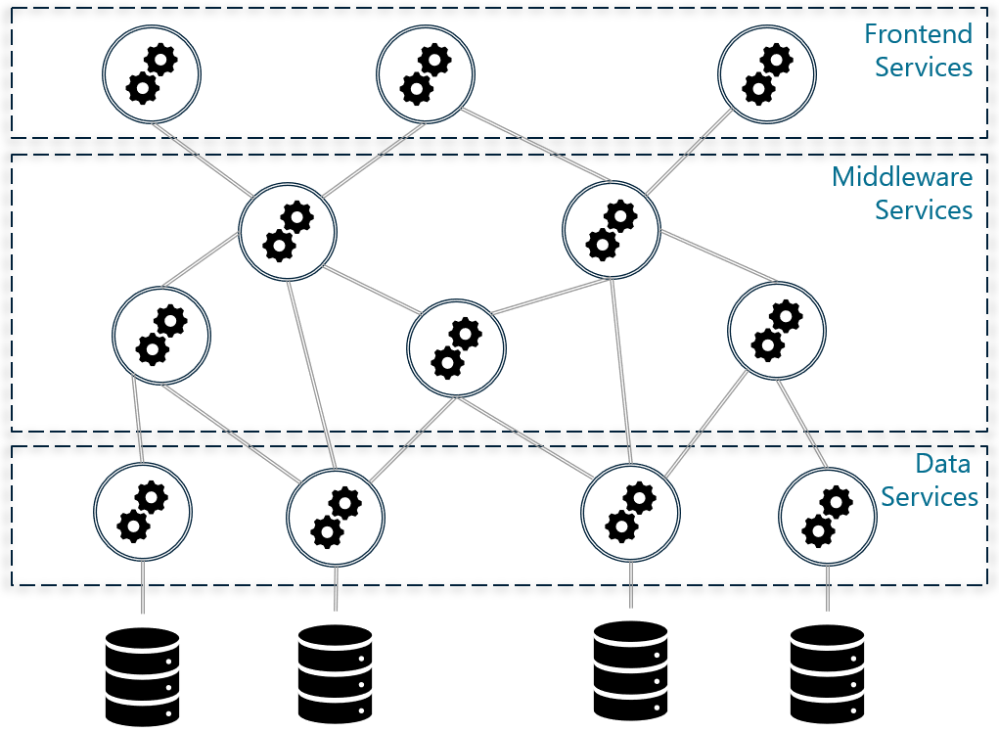
Microservice Architecture

Slide 4
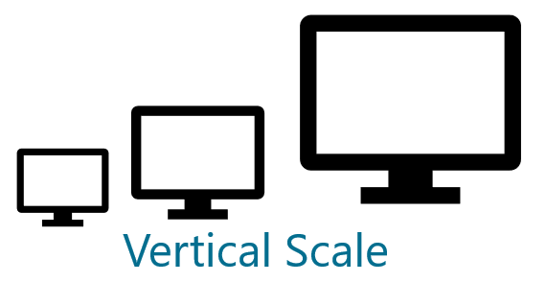
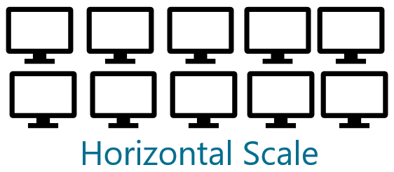
Advantage 1: Scaling

Slide 5
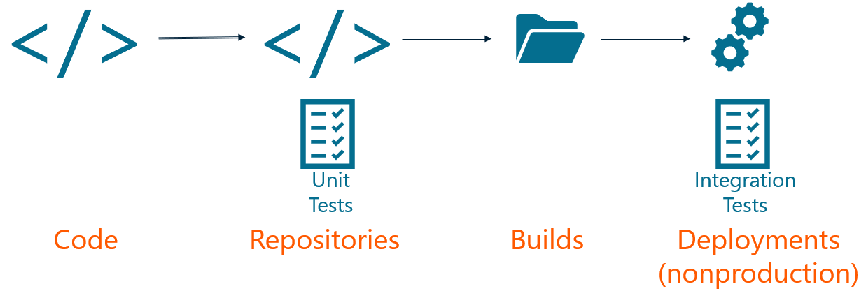
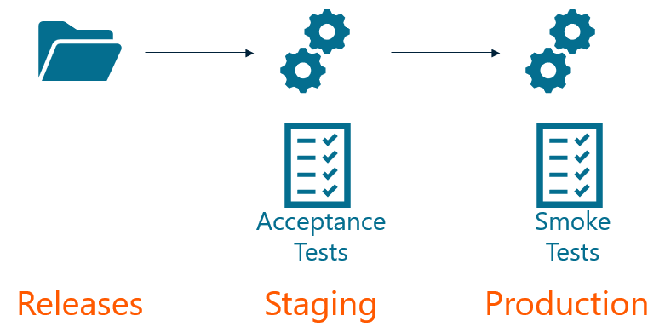
Advantage 2: Easier Upgrades
Continuous Integration
Continuous Deployment/Delivery

Slide 6
Advantage 2: Easier Upgrades
Continuous Integration
Continuous Deployment/Delivery

Slide 7
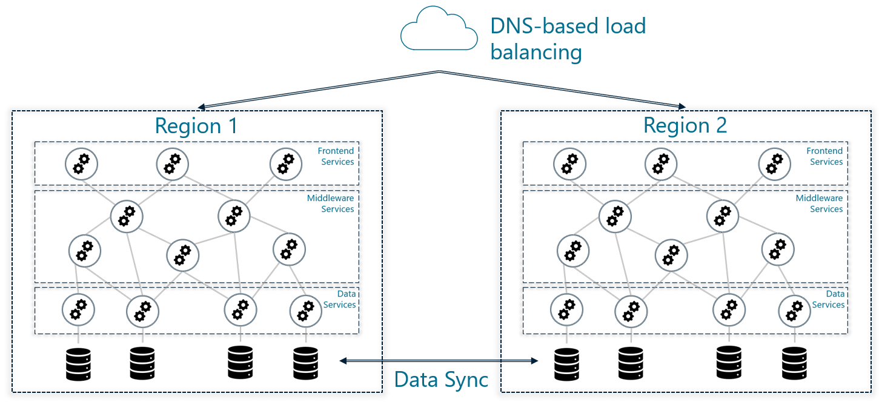
Advantage 3: Better Availability

Slide 8
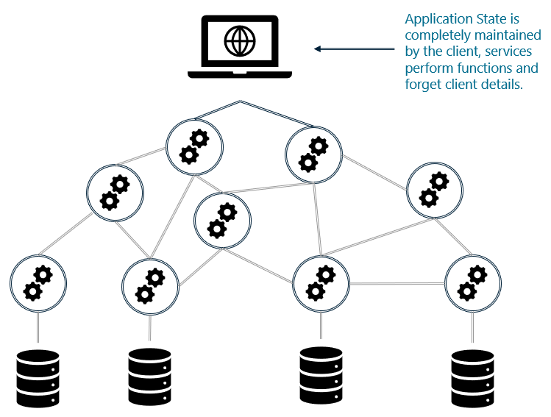
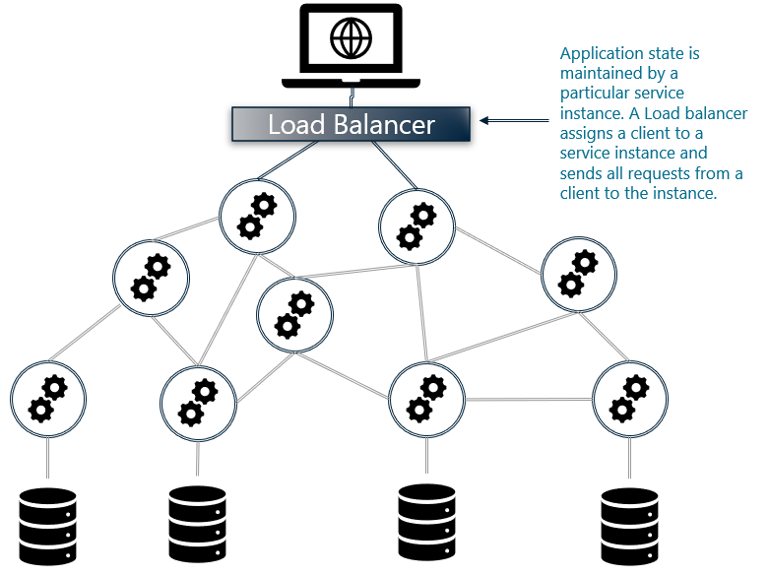
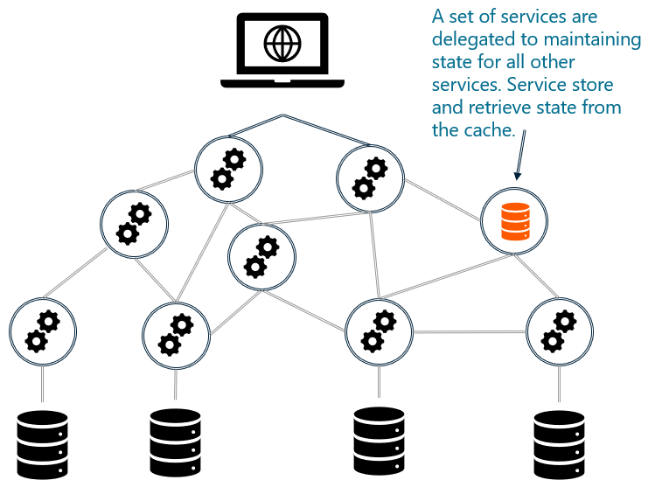
Challenge 1: State
Client Maintained State
Sticky Sessions
Distributed Cache

Slide 9
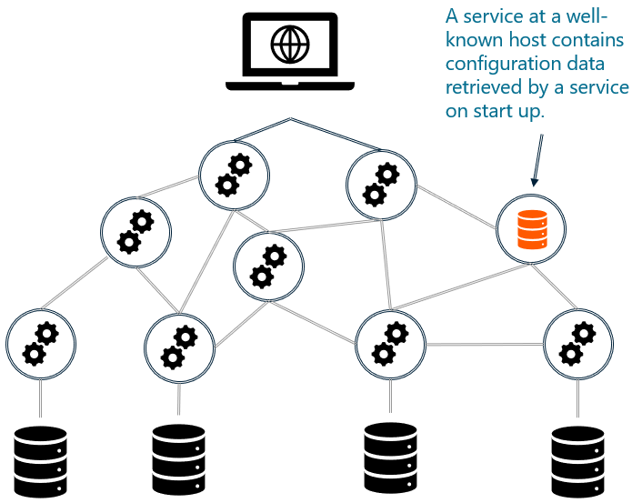
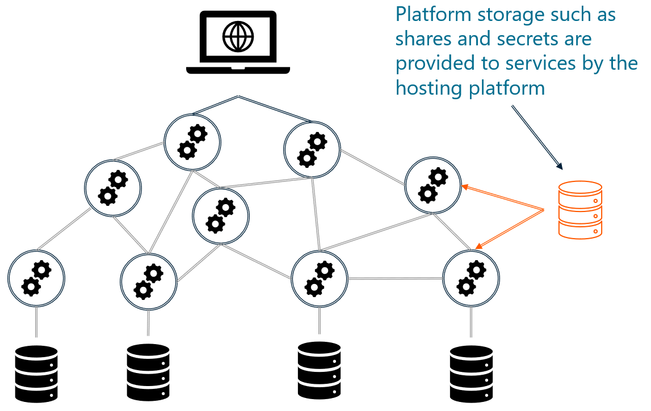
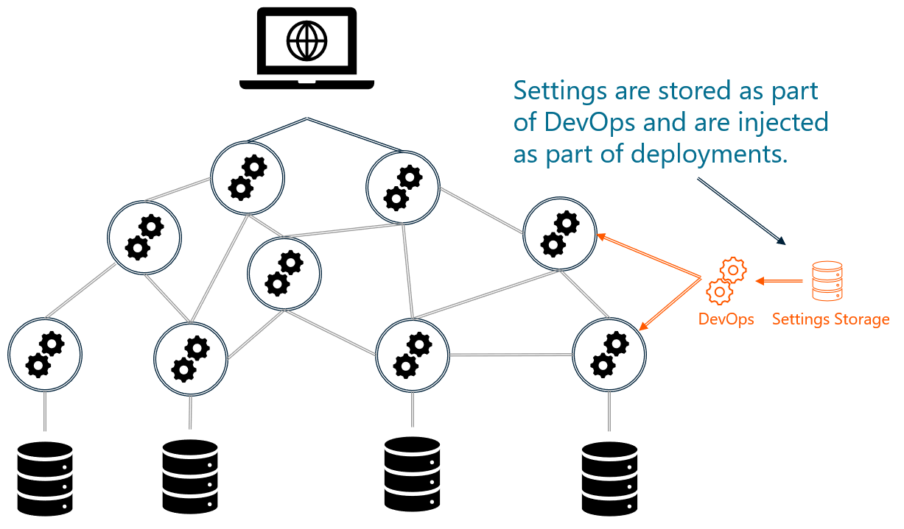
Challenge 2: Configuration Management
Configuration Service
Platform Storage
DevOps

Slide 10
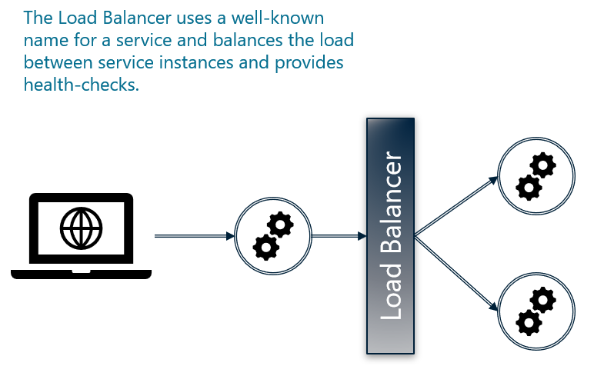
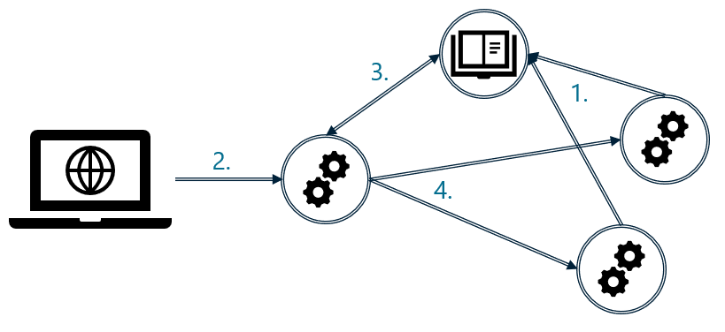
Challenge 3: Service Discovery
DNS-based Discovery
Discovery Service
Services self-register
A client makes a request
A service finds a service endpoint
A service calls a service.

Slide 11
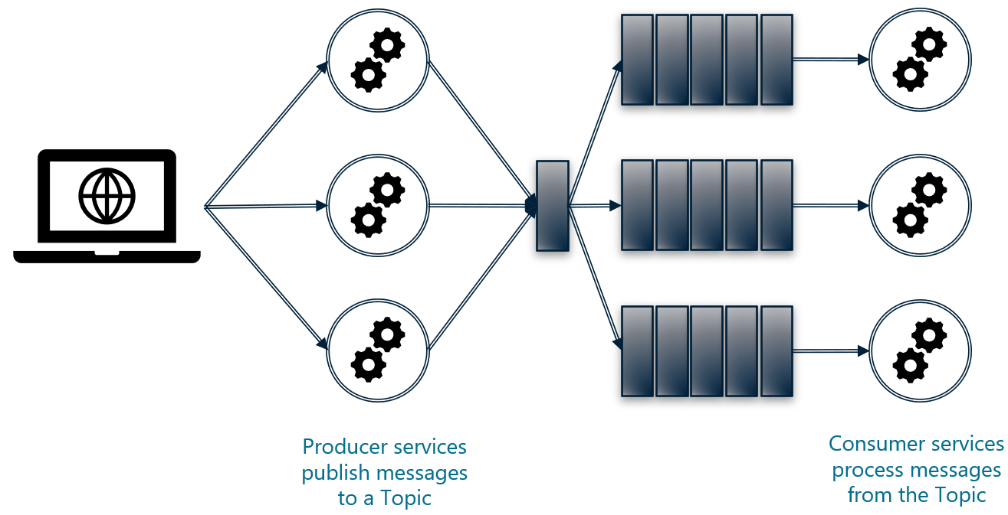


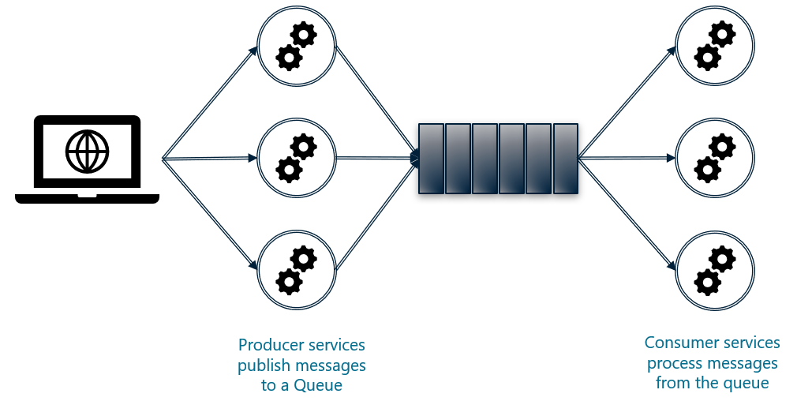
Challenge 4: Interservice Communication
Asynchronous (Topics)
Synchronous (HTTP, Etc.)
Asynchronous (Queues)

Slide 12
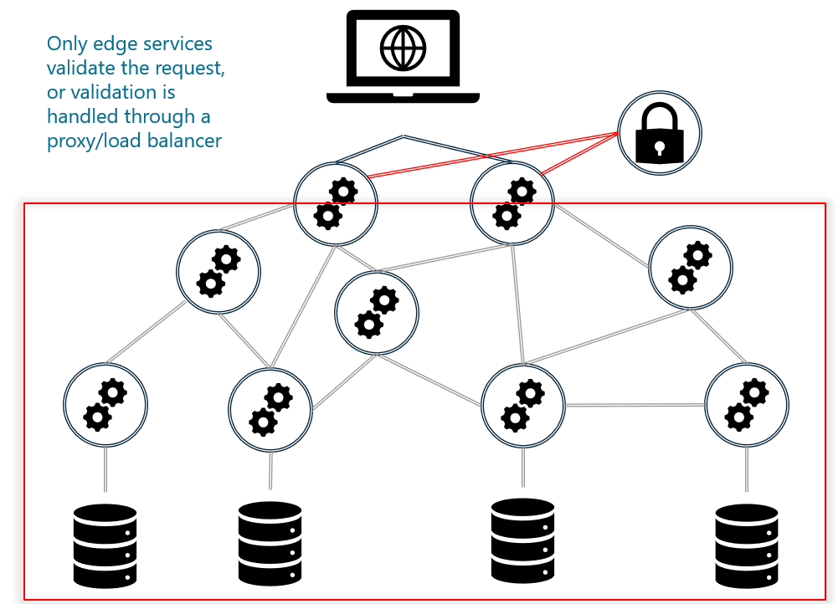
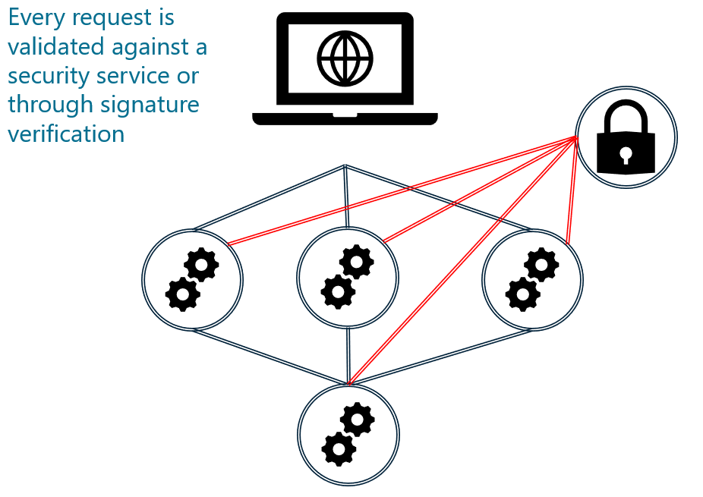
Challenge 5: Security
Trusted
Zero Trust

Slide 13
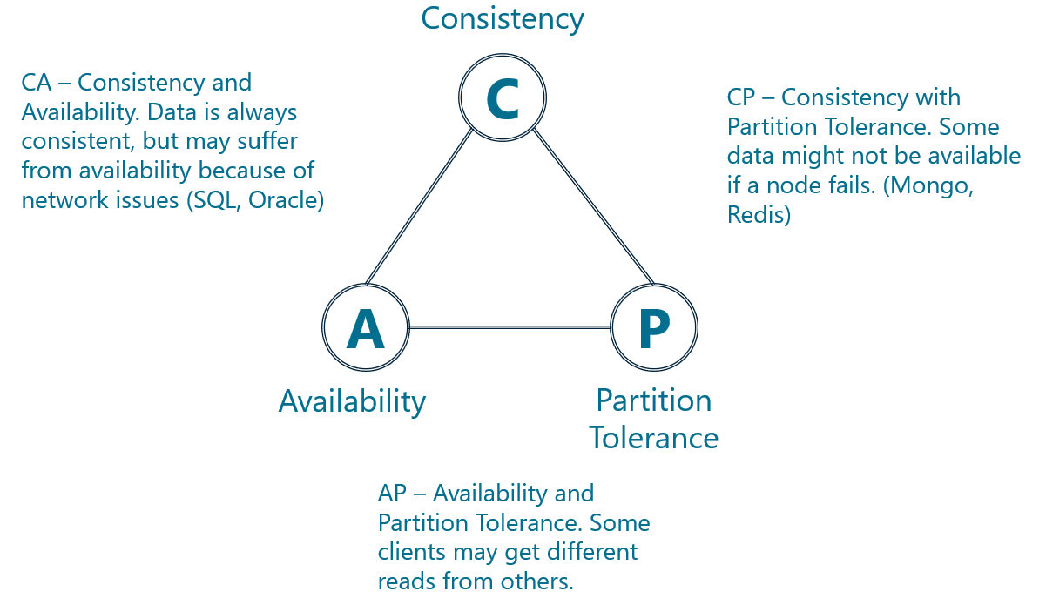
Challenge 6: CAP Theorem

Slide 14
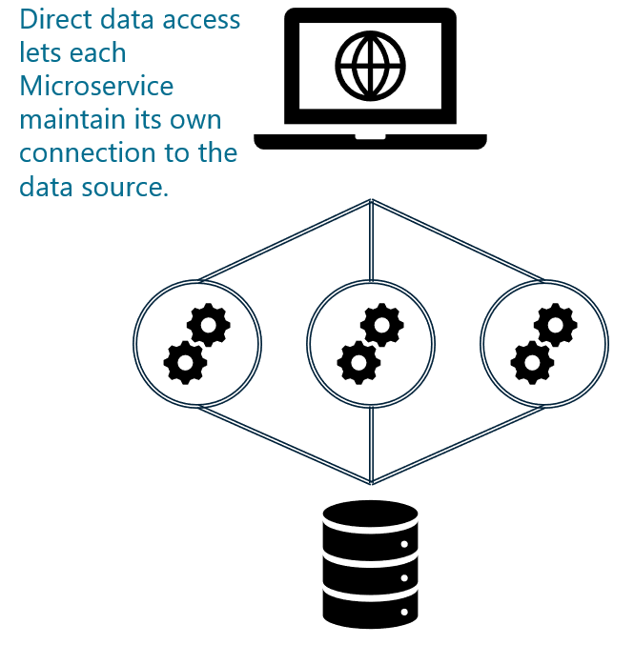
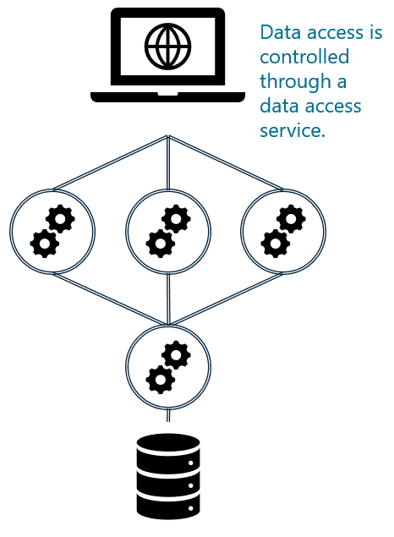
Challenge 6: Data Access
Direct
Indirect

Slide 15
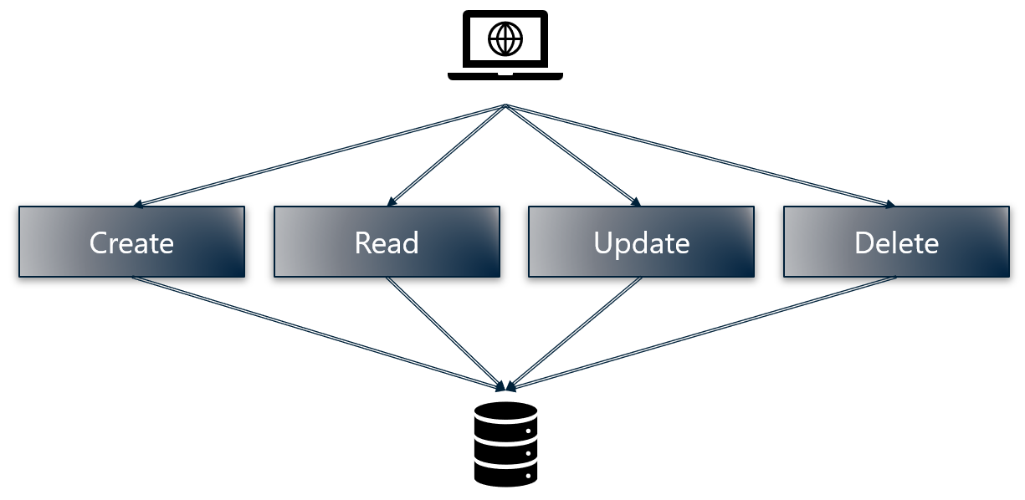
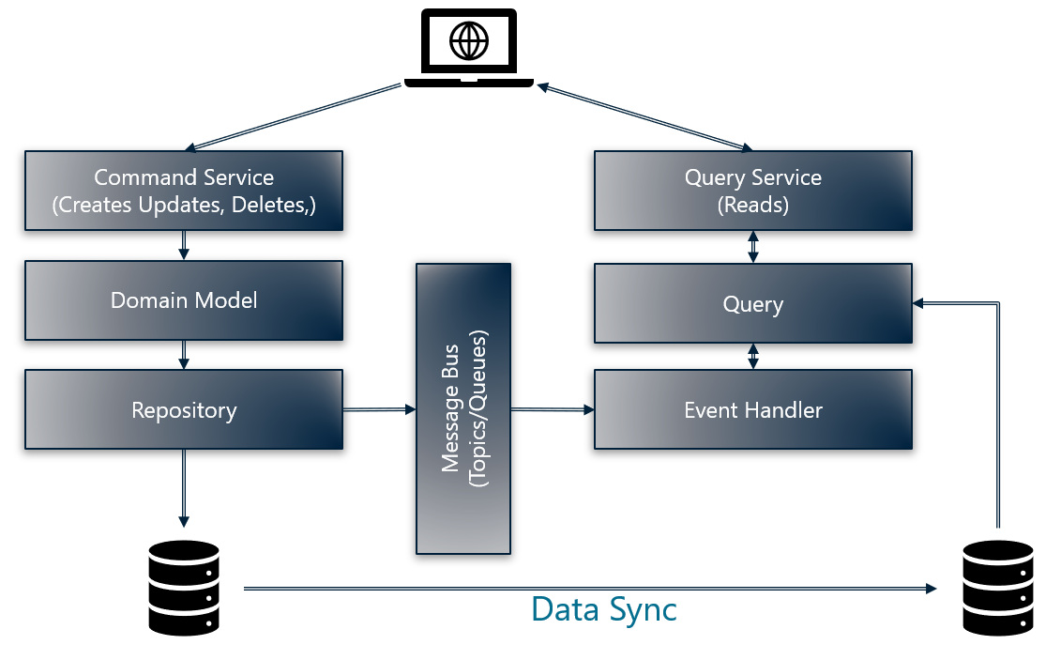
Challenge 6: Data Access
CRUD
CQRS

Slide 16
Best Practices
Implement a single responsibility pattern for services to ensure that service only do one thing.
Make as many services as possible stateless. Services that need state should store state in a distributed cache.
Refactor code to get away from sticky sessions.
Prefer asynchronous messaging.
Prefer indirect, asynchronous data access through a data service.
Prefer eventual consistency for data.
Adopt CQRS for data access services and database designs.
Leverage automation wherever possible for scaling, deployment, and configuration.
Prefer zero-trust security.

Slide 17
Serverless
Examples | Azure Functions
Scaling | Automatically handled by PaaS provider.
High Availability | Automatically handled by PaaS provider.
State Management | Stateless. State can be maintained at some level with durability. Any session state should be stored in a cache or passed as part of the request.
Configuration Management | Generally, self-configuring from settings.
Service Discovery | No built-in services discovery. Generally handled through DNS and well-known hosts.
Interservice Communication | Depends on the serverless bindings for inputs and outputs, serverless can generally be adapted for synchronous or asynchronous communication.
Security | No inherent security. However, most serverless platforms offer bolt-on options for service authentication.
Versioning | No inherent versioning therefore would need to be included.
Data Access | Serverless prefers asynchronous access to external systems. Therefore this should be a consideration for data access.

Slide 18
Containers
Examples | Azure Kubernetes Services, Azure RedHat OpenShift
Scaling | Instances scale across available nodes. Infrastructure scales with containers based on configurations.
High Availability | Built-in high availability for application and infrastructure and fault tolerance with integrated monitoring for both solutions.
State Management | A distributed cache can be brought along as a containerized service or as an external service to the microservice suite. Cloud providers usually provide Redis as PaaS.
Configuration Management | Container platforms such as Kubernetes provide configuration management features through secrets, shares and can be managed through DevOps with config maps and scripts.
Service Discovery | Container platforms such as Kubernetes provide service discovery through internal load balancers and ingress controllers that act as well-known hosts to services on the container cluster.
Interservice Communication | Container platforms such as Kubernetes provide contiguous networking across nodes to simplify communication and ingress controllers for HTTP-based workloads. However, there is no built-in support for messaging platforms, so this would need to be provided as a service in containers or externally
Security | HTTP ingress controllers can provide some basic protection for services. More robust security can be implemented with a service mesh like Istio.
Versioning | Container platforms such as Kubernetes provide specialized controllers for microservices with features to enable graceful transitions between new and old versions of services, including connection draining and rollback options.
Data Access | Containers are versatile, so they can host any number of different kinds of applications. For microservices, however, it's best to prefer asynchronous data access

Slide 19
API’s
Examples | API’s on Azure App Services, API’s on IIS
Scaling | Application instances do not scale automatically, but features in the PaaS offerings can enable autoscaling for hosted applications.
High Availability | Automatically handed by the PaaS offering.
State Management | A distributed cache can be brought along as a stand-alone service or as an external service to the microservice suite. These are offered as a service on many cloud providers.
Configuration Management | Generally, self-configuring from settings.
Service Discovery | No built-in services discovery. Generally handled through DNS and well-known hosts.
Interservice Communication | API’s work over HTTP/HTTPS, so API’s hosted on PaaS are limited to synchronous communication.
Security | No inherent security. However, most PaaS platforms offer bolt-on options for service authorization.
Versioning | No inherent versioning therefore would need to be included.
Data Access | APIs can handle any number of different kinds of applications. For microservices, however, it's best to prefer asynchronous data access

Slide 20
Blaize Stewart
@theonemule
http://youtube.com/wintellectnow
bstewart@wintellect.com

